Slide 1
Computer Vision
Modelisation

Slide 2
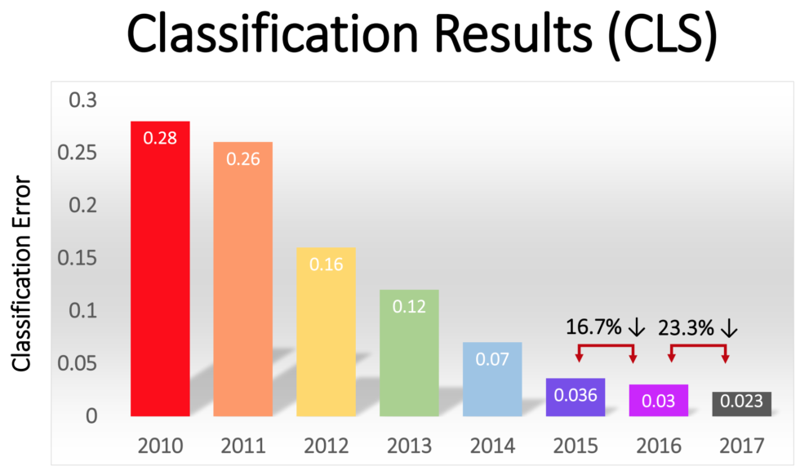
Plan
CNN
Convolution layer
Pooling layer
Fully-connected layer
Transfert learning
Purpose
Strategies
Performance evaluation
Hyperparameters
Fitting

Slide 3
CNN
“Learn” the features

Slide 4
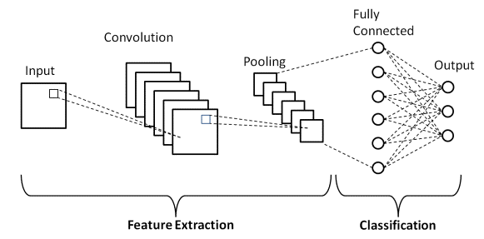
CNN

Slide 5
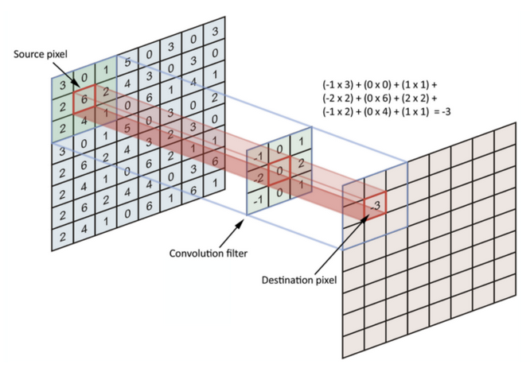
CNN: convolution layer
Activation function:
ReLU: f(x) = Max(0, x)
Notes:
https://towardsdatascience.com/simple-introduction-to-convolutional-neural-networks-cdf8d3077bac
https://towardsdatascience.com/convolutional-neural-networks-explained-9cc5188c4939

Slide 6
CNN: convolution layer
Image (input):
W : width (pixels)
H : hight (pixels)
D : number of channels
Hyperparameters:
K : number of filters
F : filter size in pixels (F x F x D)
S : sliding step (pixels)
P : 0 padding (pixels)
Feature maps (output):
Wc : (W - F + 2P) / S + 1
Hc : (H - F + 2P) / S + 1
Dc : K
Common choice:
F = 3 or 5
S = 1 or 2
P = 1

Slide 7
CNN: pooling layer
Advantages:
Dimension reduction
Less sensitive to feature position
Notes:
Les valeurs maximales sont repérées de manière moins exacte dans les feature maps obtenues après pooling que dans celles reçues en entrée – c'est en fait un grand avantage ! En effet, lorsqu'on veut reconnaître un chien par exemple, ses oreilles n'ont pas besoin d'être localisées le plus précisément possible : savoir qu'elles se situent à peu près à côté de la tête suffit !

Slide 8
CNN: pooling layer
Feature maps (input):
W : width (pixels)
H : hight (pixels)
D : previously used number of filters
Hyperparameters:
F : cell size (F x F pixels)
S : pixels between cells
Feature maps (output):
Wp : (W - F) / S + 1
Hp : (H - F) / S + 1
Dp : D
Common choce:
F = 2 or 3
S = 2

Slide 9
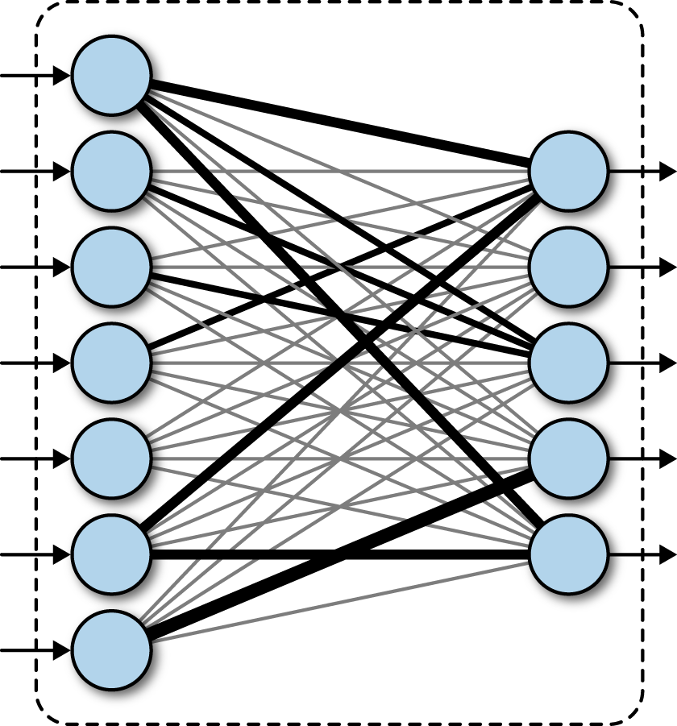
CNN: fully-connected layer
Options:
Flatten: convert output to 1D vector
Number of neurons
Dropout: rate
Activation:
ReLU
Classifier 2N: logistic regression
Classifier xN: Softmax

Slide 10
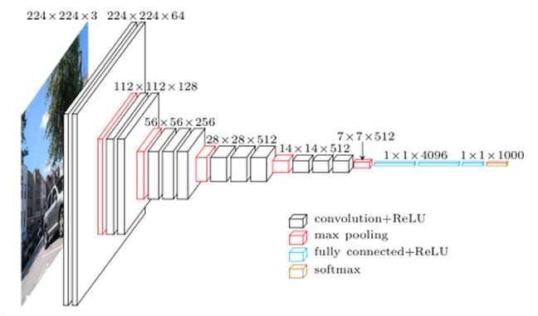
CNN: VGG16

Slide 11
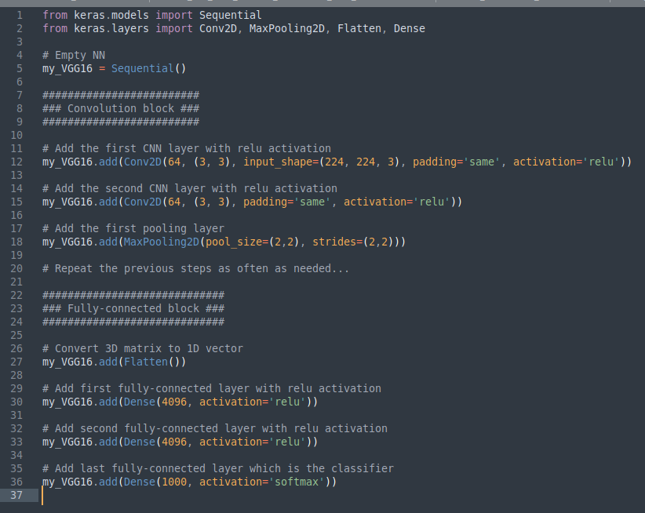
CNN: VGG16

Slide 12
Transfer learning
Time to be lazy and... smart ! :)

Slide 13
Transfer learning: purpose
Weights:
Convolution layer:
F : filter size
K : number of filters
weights = F x F x K + K
Fully-connected:
W : width of input
H : height of input
K : number of filters
N : number of neurons
Weights = W x H x K x N + N
VGG16 = 138 357 544 weights !!!

Slide 14
Transfer learning: strategies
Strategies:
Fine-tuning total:
Train all weights
Large dataset
Feature extraction:
Fix all weights
Beside the ones of the classifier
Small / similar dataset
Fine-tuning partial:
Fix some of the weights
Most likely in the first layers
Small / different dataset
The idea:
Keep the architecture
Replace the classifier

Slide 15
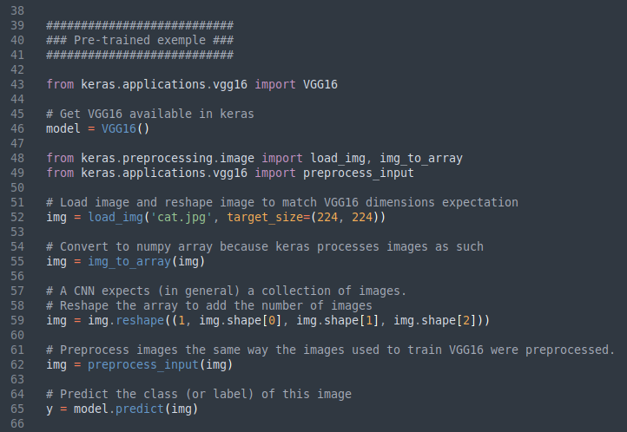
Transfer learning: exemple

Slide 16
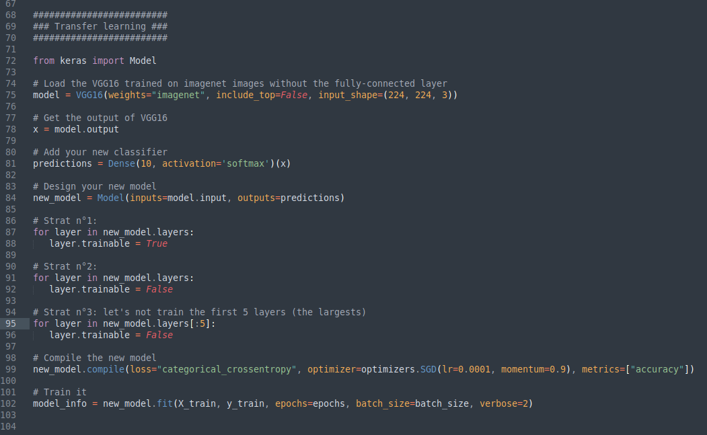
Transfer learning: exemple

Slide 17
Performance evaluation
The suspense is intense !

Slide 18
Hyperparameters
Loss function
Optimizer:
Learning rate
Momentum
Metrics

Slide 19
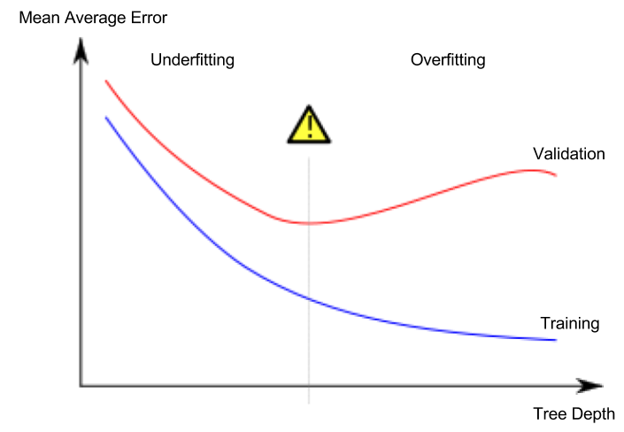
Underfitting vs. Overfitting
Loss
my_model.fit(X_train, y_train,
early_stopping_rounds=5,
eval_set=[(X_valid, y_valid)],
verbose=False)
Epoch

Slide 20
Practice
You know the drill

Slide 21




Ai design: dataset / concept
Select a dataset or an app idea
Create your team !
Define your strategy
Prototype and test

